Slide 1
GMNN: Graph Markov Neural Networks
Jian Tang
HEC Montreal
Mila-Quebec AI Institute
CIFAR AI Research Chair
Meng Qu, Yoshua Bengio, Jian Tang. “GMNN: Graph Markov Neural Networks”. To appear at ICML’19.

Slide 2
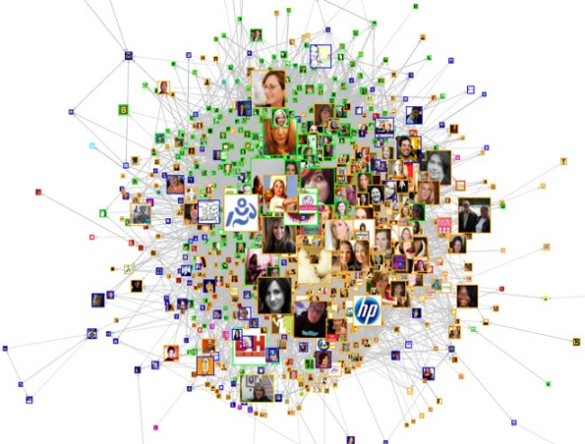
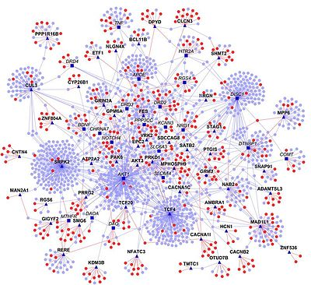
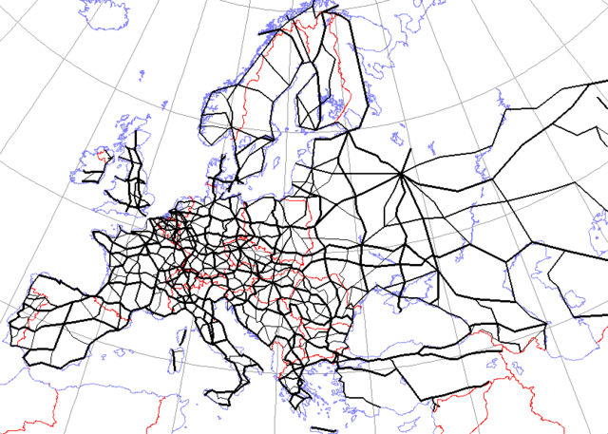
Graphs are Ubiquitous
A general and flexible data structure to encode the relations between objects
Cover a variety of domains and applications
node classification
Link prediction
Information diffusion
…
Social Network
Citation Network
Protein-protein
Interaction Network
Road Network

Slide 3
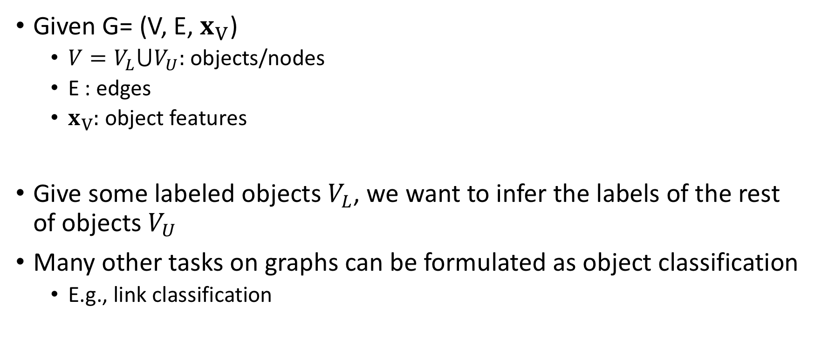
Semi-supervised Object Classification
?
Given G= (V, E, $x_{V}$)
$V=V_{L}⋃V_{U}:$objects/nodes
E : edges
$x_{V}:$object features
Give some labeled objects $V_{L}$, we want to infer the labels of the rest of objects $V_{U}$
Many other tasks on graphs can be formulated as object classification
E.g., link classification
?
Object labels
?
?
?
?
Object features

Slide 4
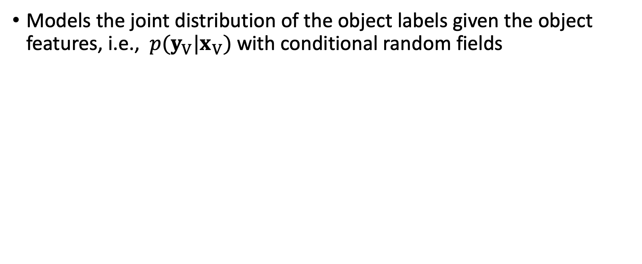
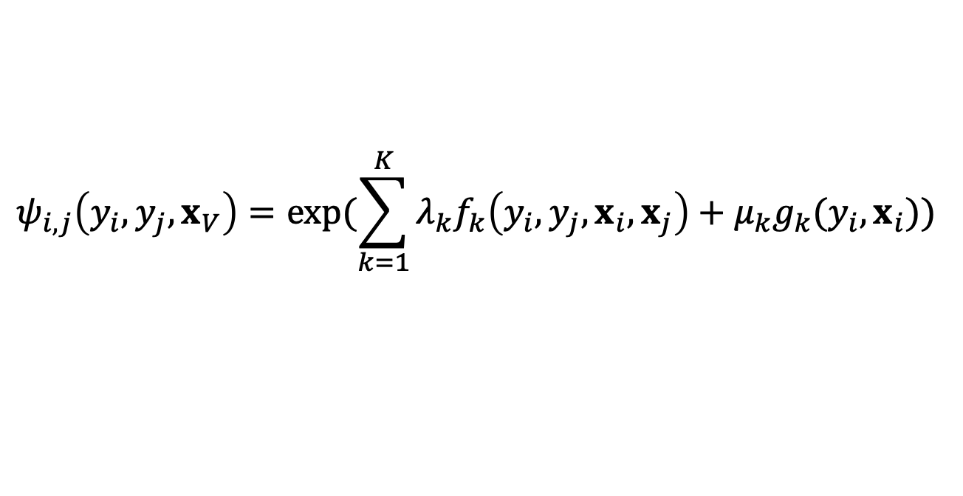
Related Work: Statistical Relational Learning
Models the joint distribution of the object labels given the object features, i.e., $p(y_{V}|x_{V})$ with conditional random fields
?
?
Object labels
?
?
?
?
Object features
$$ψ_{i,j}\left(y_{i},y_{j},x_{V}\right)=\exp{(\sum_{k=1}^{K}{λ_{k}f_{k}\left(y_{i},y_{j},x_{i},x_{j}\right)+μ_{k}g_{k}(y_{i},}x_{i})) }$$
Edge potential functions
node potential functions

Slide 5
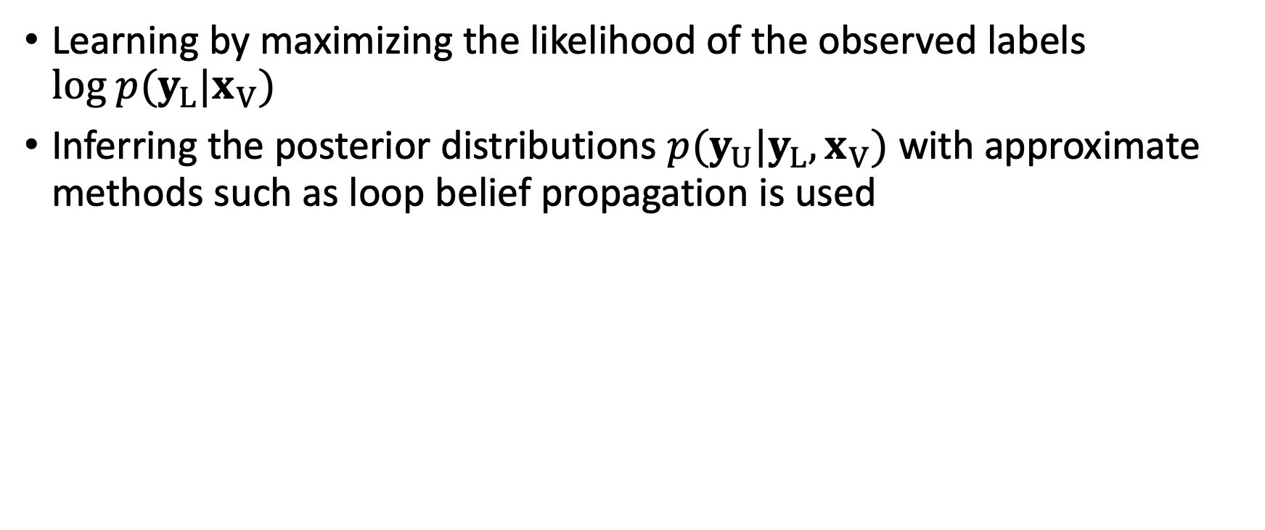
Optimization of Statistical Relational Learning
Learning by maximizing the likelihood of the observed labels $log p(y_{L}|x_{V})$
Inferring the posterior distributions $p(y_{U}|{y_{L},x}_{V})$ with approximate methods such as loop belief propagation is used

Slide 6
Pros and Cons of Statistical Relation Learning
Pros
Capable of modeling the dependency between the object labels
Cons
Some manually defined potential functions
Limited model capacity
Inference is difficult due to the complicated graph structures

Slide 7
Related Work: Graph Neural Networks
Learning effective node representations and then predicting the node labels independently
Graph convolutional Networks (Kipf et al. 2016)
Graph attention networks (Veličković et al. 2017)
Neural message passing (Gilmer et al. 2017)
Predicting the node labels independently with the node representations
?
?
Object labels
?
?
?
?
Object features

Slide 8
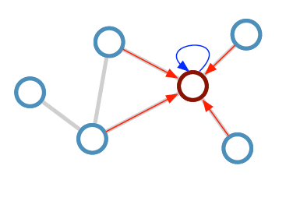
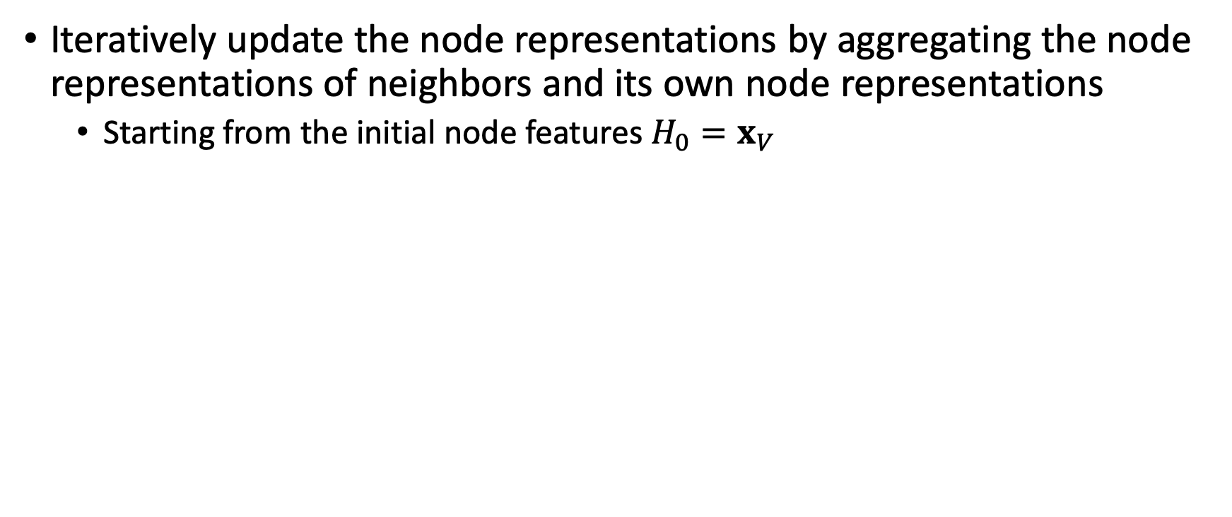
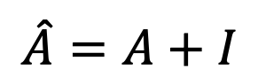
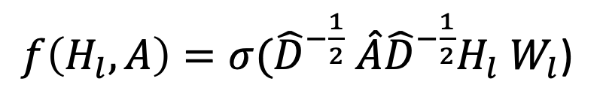
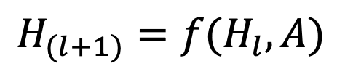
Graph Convolutional Networks (Kipf et al. 2016)
Iteratively update the node representations by aggregating the node representations of neighbors and its own node representations
Starting from the initial node features $H_{0}=x_{V}$
$$H_{(l+1)}=f(H_{l}, A)$$
$$\hat{A}=A+I$$
$f\left(H_{l}, A\right)=σ({\hat{D}}^{−\frac{1}{2}}$ $\hat{A}{\hat{D}}^{−\frac{1}{2}}H_{l}$ $W_{l}$)

Slide 9
Pros and Cos of Graph Neural Networks
Pros
Learns effective node representations by feature propagations
High model compacity by using multiple non-linear graph convolutional layers
Cons
Ignore the dependency between node labels

Slide 10
Can we combine the advantages of both worlds?

Slide 11
GMNN: Graph Markov Neural Networks (Qu, Bengio, and Tang, ICML’19)
Towards combining statistical relational learning and graph neural networks
Learning effective node representations for predicting the node labels
Modeling the label dependencies of nodes
State-of-the-art performance
semi-supervised node classification
unsupervised node representation
link classification

Slide 12
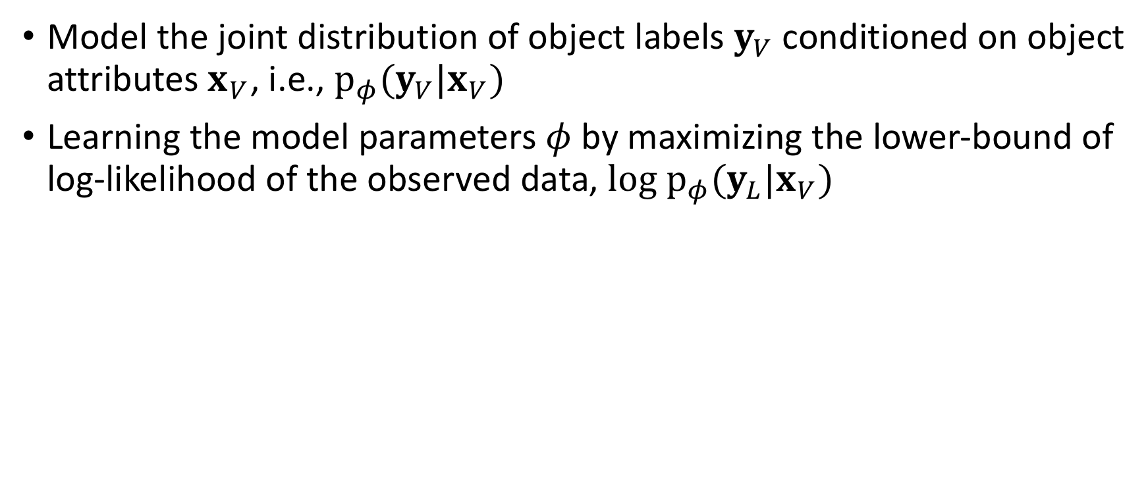
GMNN: Graph Markov Neural Networks
Model the joint distribution of object labels $y_{V}$ conditioned on object attributes $x_{V}$, i.e., $p_{φ}({y_{V}|x}_{V})$
Learning the model parameters $φ$ by maximizing the lower-bound of log-likelihood of the observed data, ${log p}_{φ}({y_{L}|x}_{V})$

Slide 13
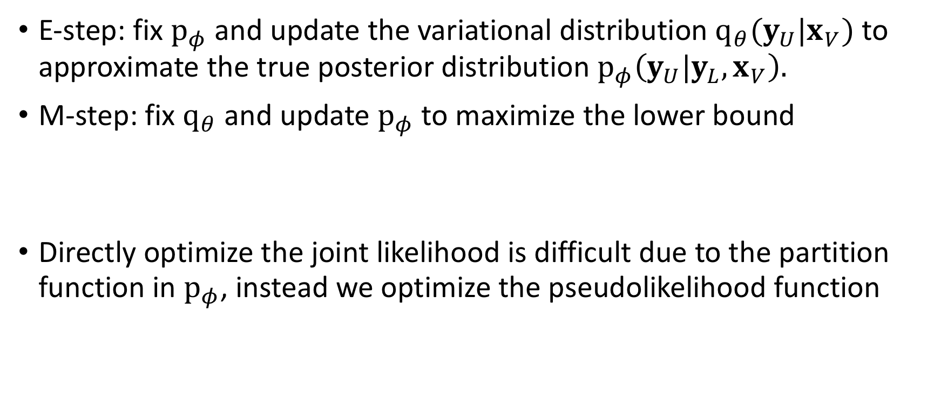
Optimization with Pseudolikelihood Variational-EM
E-step: fix $p_{φ}$ and update the variational distribution $q_{θ}({y_{U}|x}_{V})$ to approximate the true posterior distribution $p_{φ}\left({y_{U}|y_{L},x}_{V}\right).$
M-step: fix $q_{θ}$ and update $p_{φ}$ to maximize the lower bound
Directly optimize the joint likelihood is difficult due to the partition function in $p_{φ}$, instead we optimize the pseudolikelihood function

Slide 14
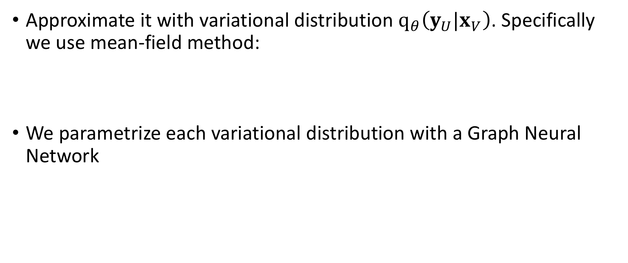
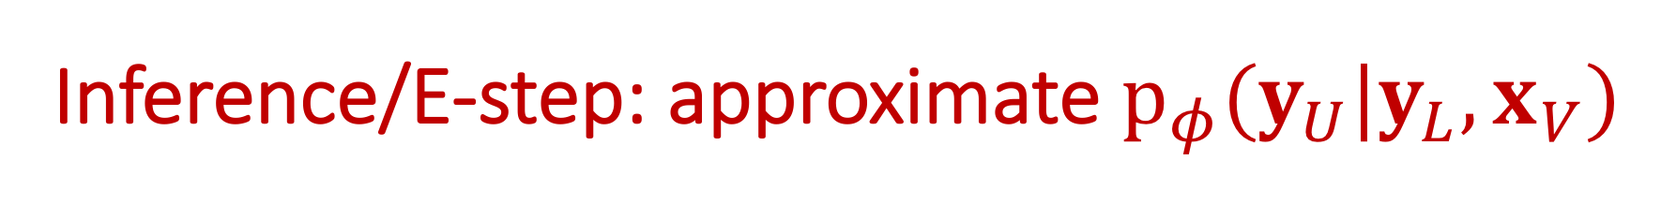
Inference/E-step: approximate $p_{φ}({y_{U}|y_{L},x}_{V})$
Approximate it with variational distribution $q_{θ}\left({y_{U}|x}_{V}\right)$. Specifically we use mean-field method:
We parametrize each variational distribution with a Graph Neural Network
Object representations learned by GNN

Slide 15
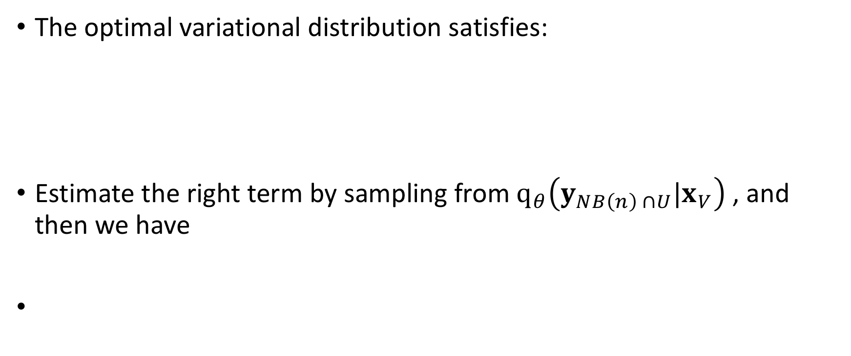
Inference/E-step: approximate $p_{φ}({y_{U}|y_{L},x}_{V})$
The optimal variational distribution satisfies:
Estimate the right term by sampling from $q_{θ}\left({y_{NB\left(n\right) ∩U}|x}_{V}\right)$ , and then we have
Label distribution of object n by the learning module

Slide 16
Inference/E-step: approximate $p_{φ}({y_{U}|y_{L},x}_{V})$
Minimize the KL-divergence between the two distributions
The supervision from the learning module is used as pseudo label to train the variational distribution
The variational distribution can also by trained on the labeled data
Final objective:

Slide 17
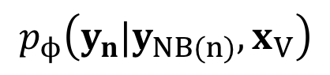
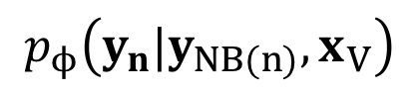
Learning/M-step:
The log-pseudo likelihood:
According to the inference, only the is required
Parametrize with another GCN
$$p_{ϕ}\left({{y_{n}|y}_{NB(n)},x}_{V}\right)$$
$$p_{ϕ}\left({{y_{n}|y}_{NB(n)},x}_{V}\right)$$

Slide 18
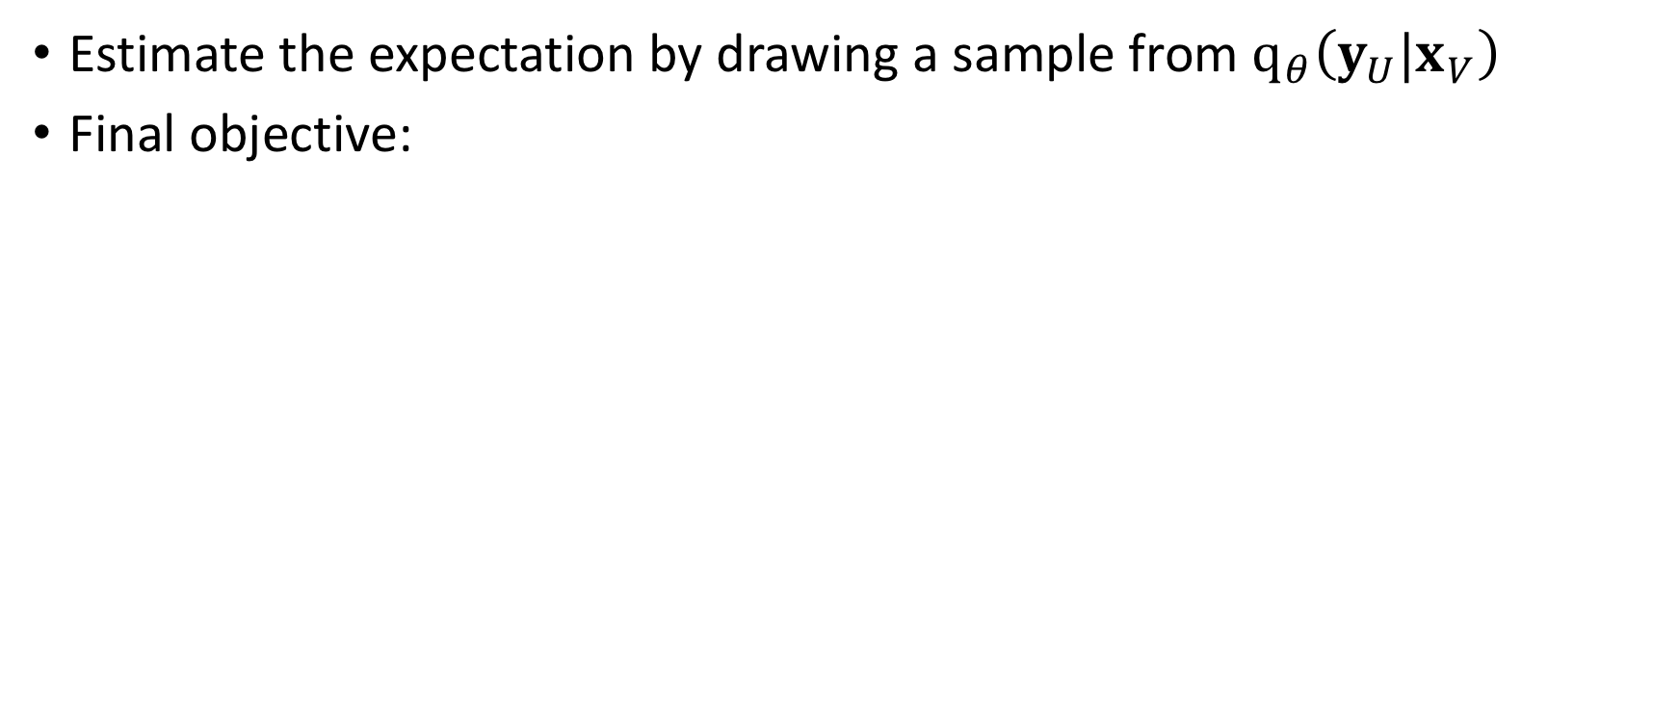
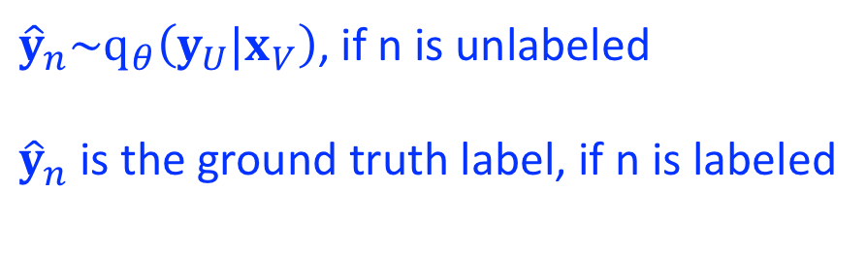
Learning/M-step:
Estimate the expectation by drawing a sample from $q_{θ}\left({y_{U}|x}_{V}\right)$
Final objective:
${\hat{y}}_{n}\sim q_{θ}\left({y_{U}|x}_{V}\right)$, if n is unlabeled
${\hat{y}}_{n}$ is the ground truth label, if n is labeled

Slide 19
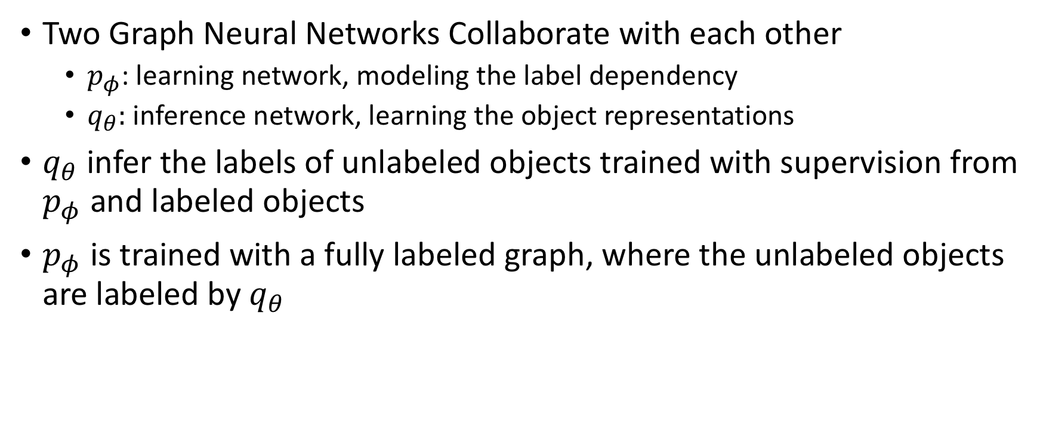
Overall Optimization Procedure
Two Graph Neural Networks Collaborate with each other
$p_{φ}$: learning network, modeling the label dependency
$q_{θ}:$ inference network, learning the object representations
$q_{θ}$ infer the labels of unlabeled objects trained with supervision from $p_{φ}$ and labeled objects
$p_{φ}$ is trained with a fully labeled graph, where the unlabeled objects are labeled by $q_{θ}$
?
?
Object labels
?
?
?
?
Object features

Slide 20
Applications: Object/Node Classification
Train, validation, and test are standard split
State-of-the-art performance

Slide 21
Results of Node Classification
Random data splits
State-of-the-art performance

Slide 22
Few-shot Learning Settings
5 labeled objects for each class
The performance gain are even larger

Slide 23
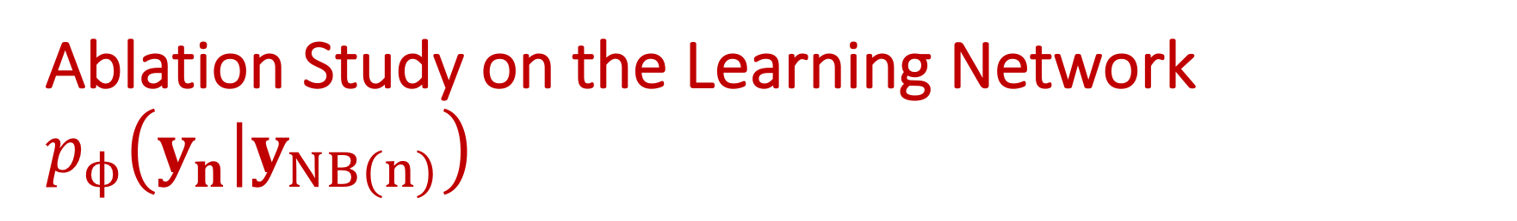
Ablation Study on the Learning Network $p_{ϕ}\left({y_{n}|y}_{NB(n)}\right)$
1 mean pooling layer: just take the average distribution of labels of neighbors,
label propagation!
Model the label dependency in a linear way

Slide 24
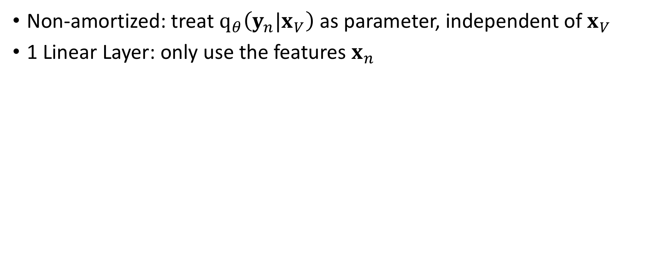
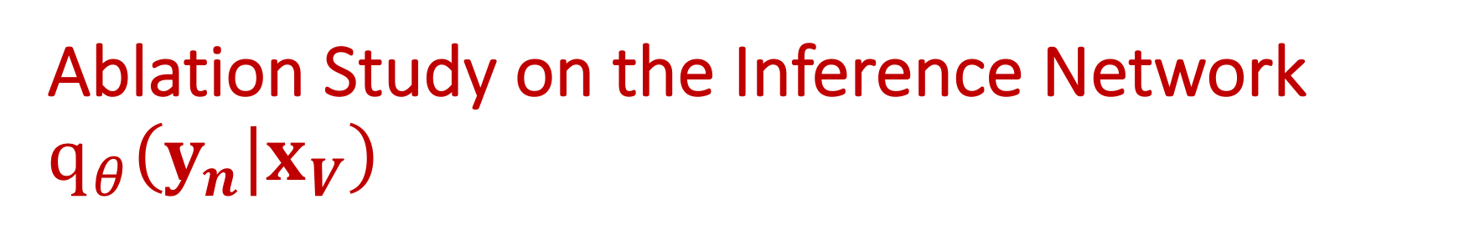
Ablation Study on the Inference Network $q_{θ}\left({y_{n}|x}_{V}\right)$
Non-amortized: treat $q_{θ}\left({y_{n}|x}_{V}\right)$ as parameter, independent of $x_{V}$
1 Linear Layer: only use the features $x_{n}$

Slide 25
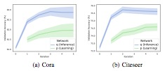
Convergence Analysis of Optimization

Slide 26
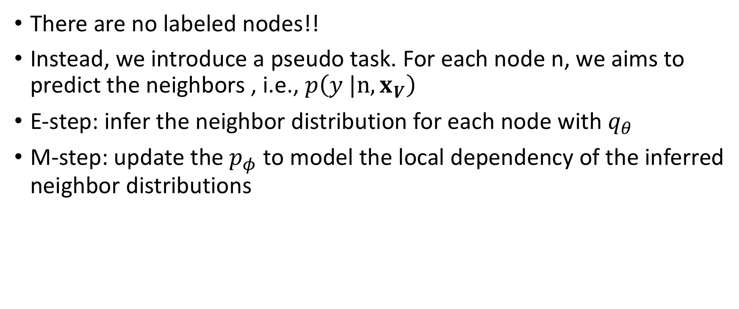
Applications: Unsupervised Node Representation Learning
There are no labeled nodes!!
Instead, we introduce a pseudo task. For each node n, we aims to predict the neighbors , i.e., $p\left(y {|n, x}_{V}\right)$
E-step: infer the neighbor distribution for each node with $q_{θ}$
M-step: update the $p_{φ}$ to model the local dependency of the inferred neighbor distributions

Slide 27
Node/Object classification
DGI: Deep Graph Infomax, Veličković et al. 2019

Slide 28
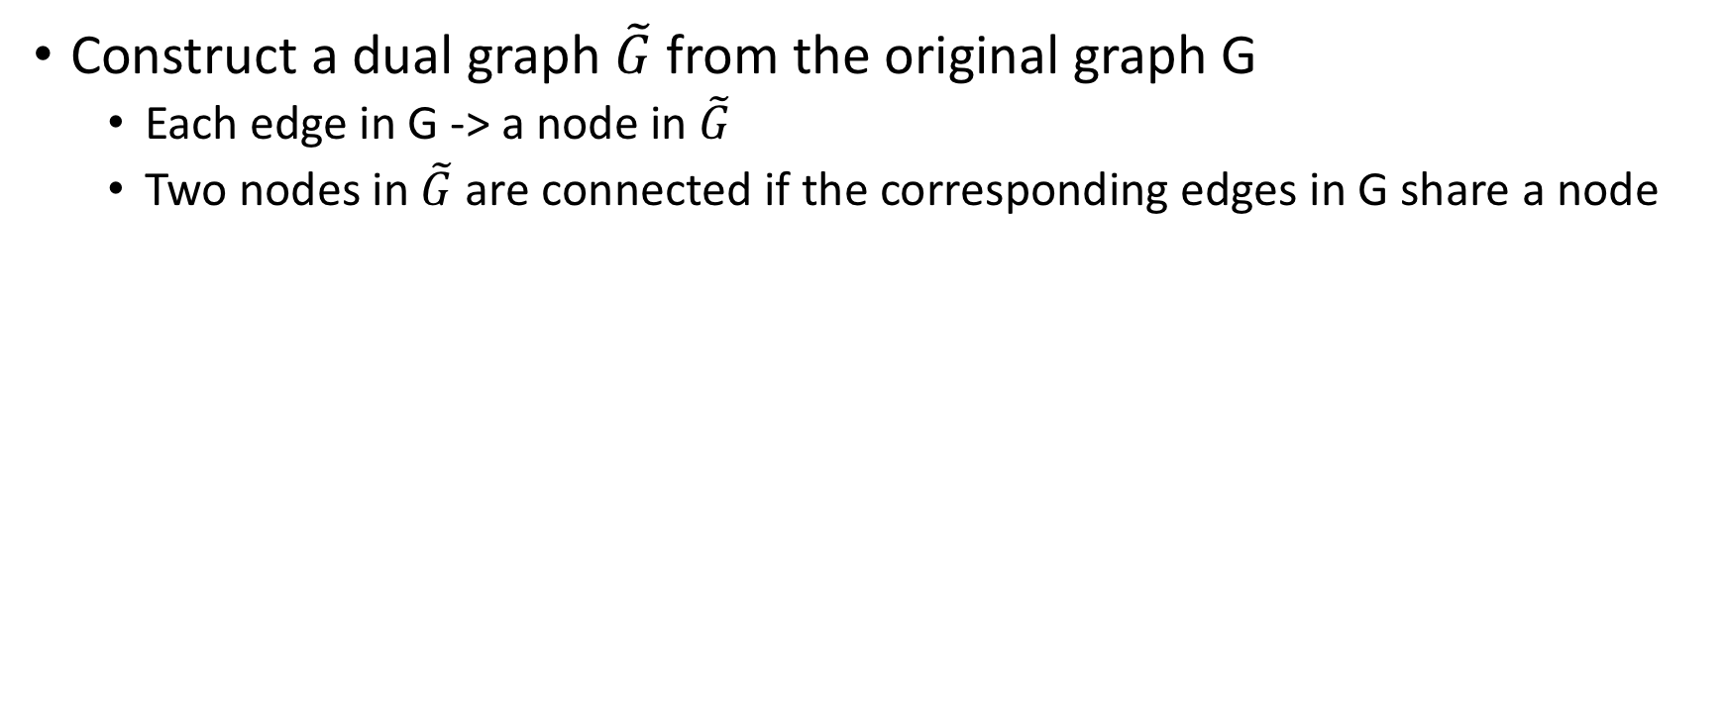
Applications: Link Classification
Construct a dual graph $\tilde{G}$ from the original graph G
Each edge in G -> a node in $\tilde{G}$
Two nodes in $\tilde{G}$ are connected if the corresponding edges in G share a node

Slide 29
Summary
A fundamental problem on graphs: semi-supervised node classification
GMNN: towards combining statistical relational learning and graph neural networks
Model the label dependency with one graph neural network
Learn effective node representations with another graph neural network
State-of-the-art results on semi-supervised node classification, unsupervised node representation, and link classification
Code available at: https://github.com/DeepGraphLearning/GMNN

Slide 30
Questions?

